Slide 1

Sample 1
WHY MLOPS? – A COHESIVE ENVIRONMENT THAT ENABLES…
MACHINE LEARNING
DATA ACQUISITION
BUSINESS UNDERSTANDING
MACHINE LEARNING METHODOLOGIES
MACHINE LEARNING • DEVELOPMENT • OPERATIONS
DEVELOPMENT
CONTINUOUS INTEGRATION
MODELING + TESTING
DEPLOYMENT EFFICIENCY
OPERATIONS
CONTINUOUS DELIVERY
DATA FEEDBACK LOOP
MODEL MONITORING

Slide 2




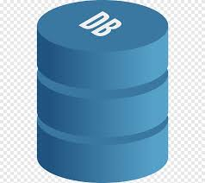

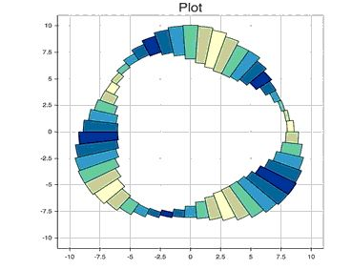
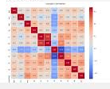
OUR APPROACH
DATA IS CURATED AND COLLECTED FROM A RT SOURCE
REPORTS
Storage
1
CUBEFLOW & KUBERNETES FOR CONTINUOUS DEPLOYMEMT
File Drop
2
File Drop
3
MODEL RESULTS HISTORY SAVED IN DB
DATA SCIENCE AND ML WORKSTATION

Slide 3


DASHBOARDS
MLOPS REPORTS EXAMPLES
STABILITY METRICS & REPORTS
PSI – POPULATION STABILITY INDEX
DIVERGENCE INDEX
PERFORMANCE METRICS & REPORTS
K-S, RMSE, AUC-ROC, R-SQUARED, CONFUSION MATRIX WITH COST
OPERATIONS METRICS & REPORTS
ML AND PIPELINE HEALTH

Slide 4
Sample 1
DEMO: PREDICTING TAXI CAB TRIP TIME…
Recalibrating models in real time with the most up to date data helps us to identify estimated trip times and increases overall productivity and efficiency for the business.
Data Fetch Queries
Tensorflow ML Models
Kubeflow Pipelines
Reports
Scripts and procedures enables to fetch data at any set interval for extraction of the training and validation data sets
Drop zones for data input and output
Model development environment on GCP using JupyterHub.
Demo Tensorflow model developed to predict trip time on the onset of the trip
Automated retriggering established based on recalibration events using Kubeflow pipelines
Model retriggering events initiate new model estimates and reports on accuracy of the model and the cost/benefit analysis for the org.

